Slide 1
Multimedia databases
-Harsh Darji(810131016)
https://harshdarji23.github.io/

Slide 2
Contents:
What is Multimedia database?
Multimedia Database Management System
Types of Multimedia Database Management System
Multimedia Database Architecture
Multimedia Data Domain Types
Multimedia Database Applications
Issues and Challenges
Conclusion

Slide 3


What is a multimedia Database?
Multimedia Database is a collection of related multimedia data.

Slide 4
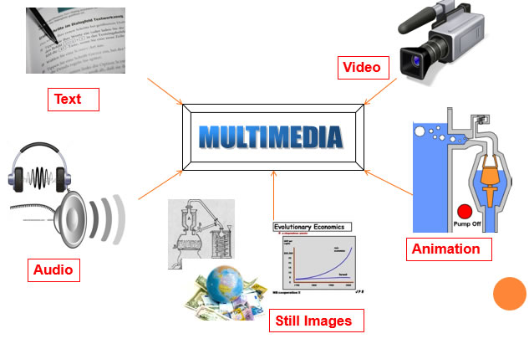
Multimedia Database

Slide 5
Categories of Multimedia database
Medium | Elements | Time-dependence
Text | Printable characters | No
Graphic | Vectors, regions | No
Image | Pixels | No
Audio | Sound, Volume | Yes
Video | Raster images, graphics | Yes
1.Static Media:
Texts
Handwritings
2.Dynamic Media:
Video
Sound bytes
3.Dimensional media:
3D-games
CAD

Slide 6
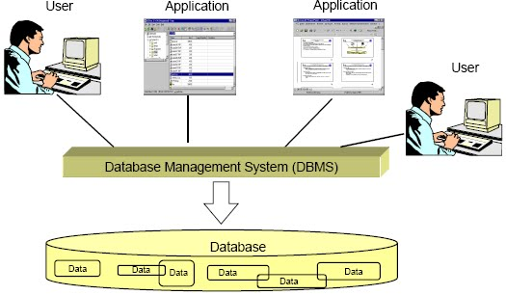
MULTIMEDIA DATABASE MANAGEMENT SYSTEM
A Multimedia Database Management System (MMDBMS) is a framework that manages different types of data potentially represented in a wide diversity of formats on a wide array of media sources.
It provides support for multimedia data types, and facilitate for creation, storage, access, query and control of a multimedia database.

Slide 7
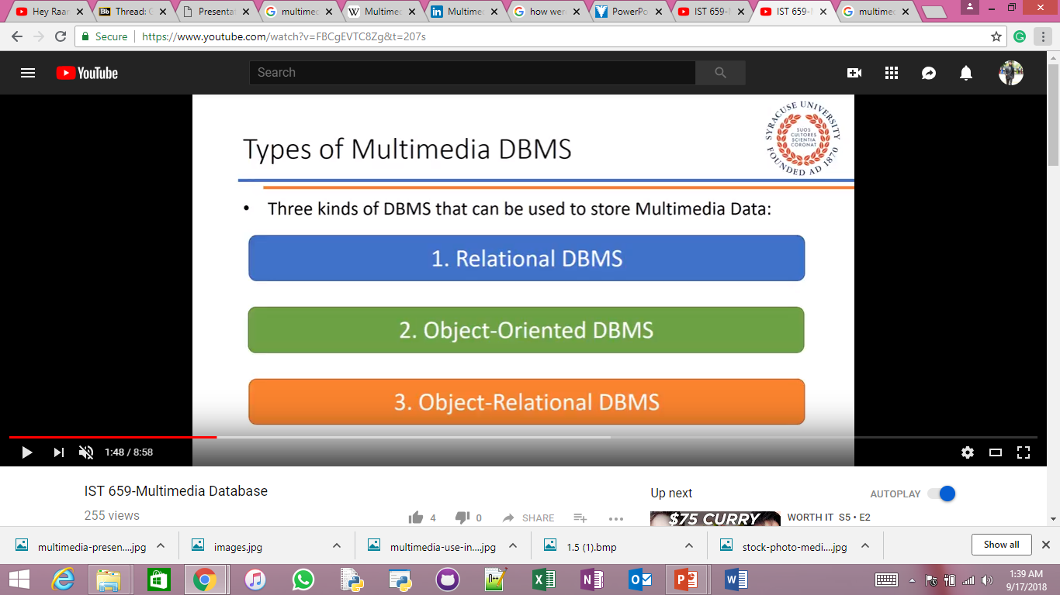
Types of multimedia database management system

Slide 8
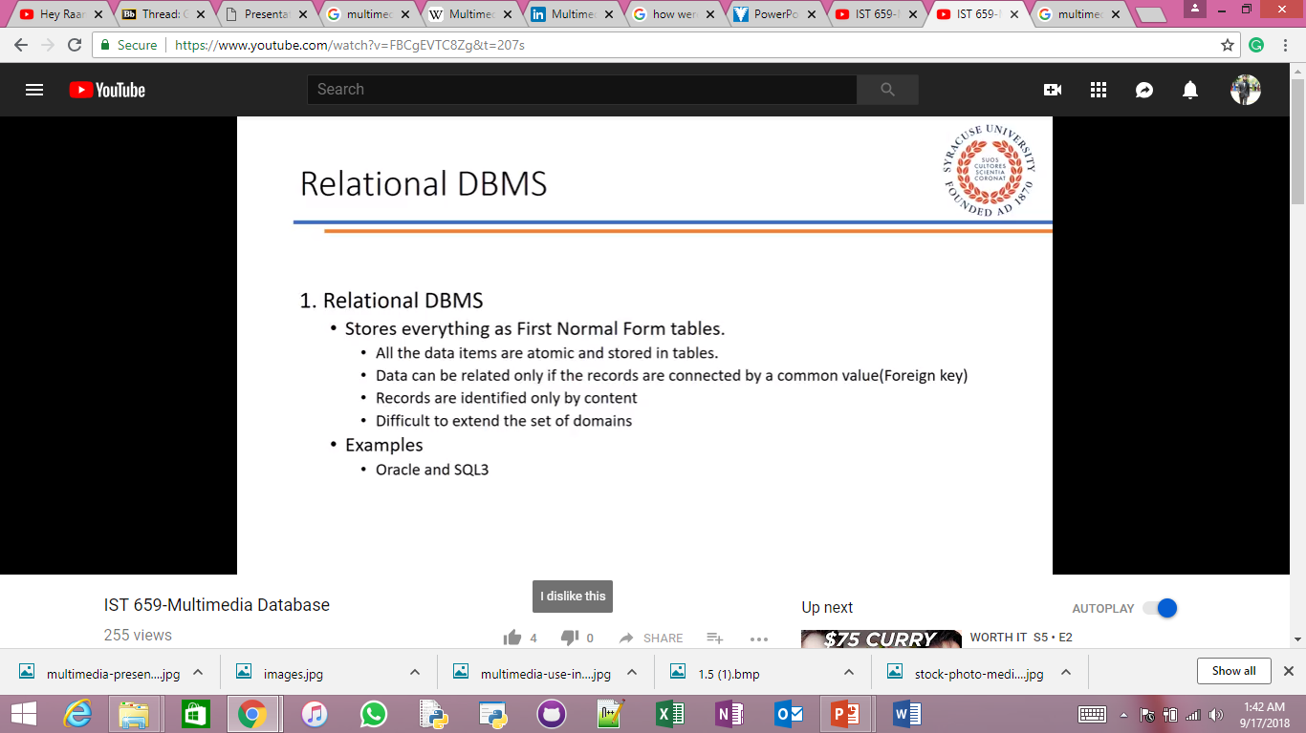

Slide 9
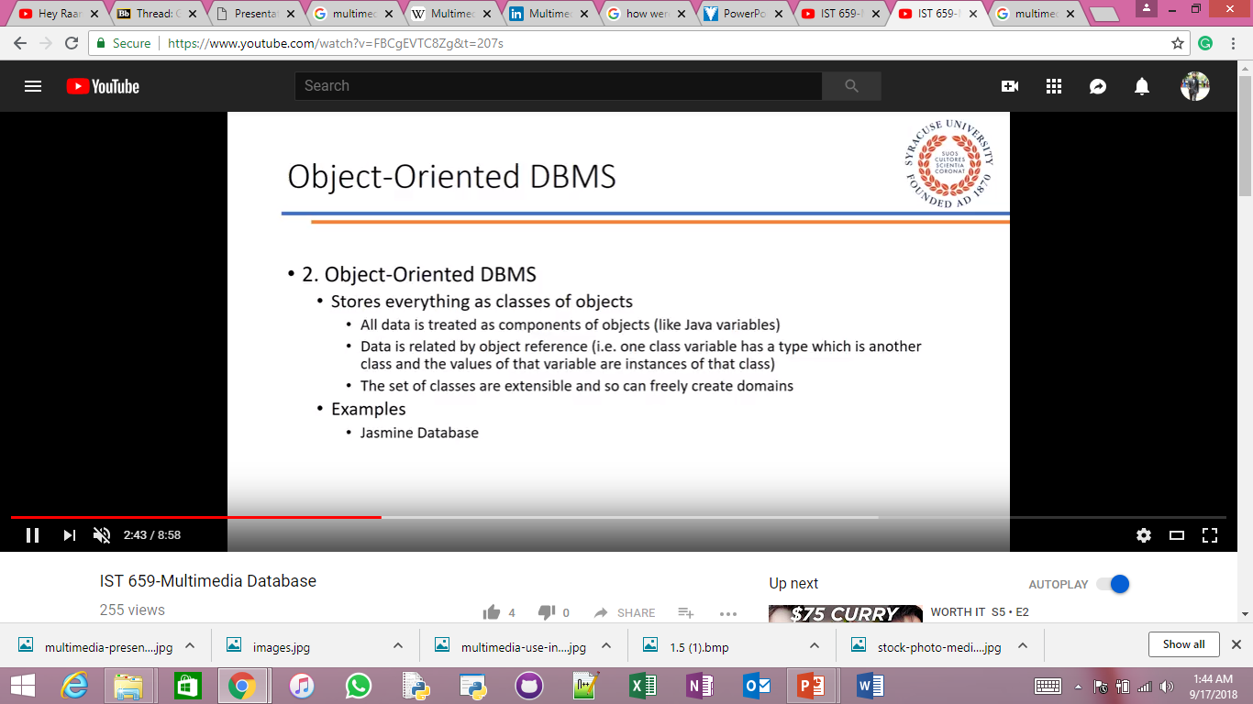

Slide 10
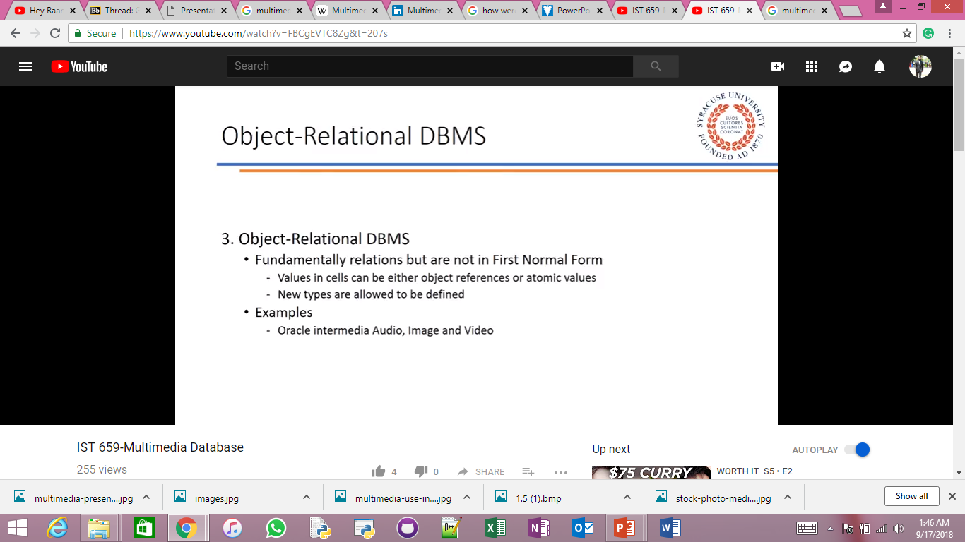

Slide 11
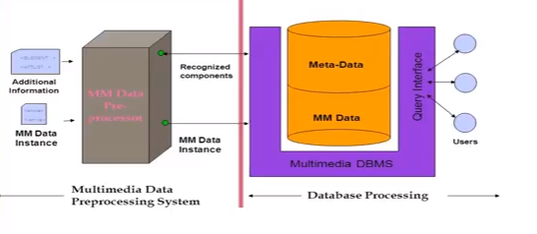
Multimedia database architecture

Slide 12
Multimedia data domain types
BLOB
Large Object Domain
File References
3. Genuine Multimedia data types
CLOB
OLE IN ACESS
ORACLE
JASMINE

Slide 13

APPLICATIONS
Digital Libraries
News-on-Demand
Video-on-Demand
Music database
Geographic Information Systems (GIS)
Telemedicine

Slide 14
Issues and challenges
Multimedia data consists of a variety of media formats or file representations including TIFF, BMP, PPT, IVUE, FPX, JPEG, MPEG, AVI, MID, WAV, DOC, GIF, EPS, PNG, etc. Because of restrictions on the conversion from one format to the other, the use of the data in a specific format has been limited as well. Usually, the data size of multimedia is large such as video; therefore, multimedia data often require a large storage.
Multimedia database consume a lot of processing time, as well as bandwidth.
Some multimedia data types such as video, audio, and animation sequences have temporal requirements that have implications on their storage, manipulation and presentation, but images, video and graphics data have special constraints in terms of their content.

Slide 15
Conclusion
Creating digital media is not expensive, but it’s generally expensive to manage and distribute it.
Browsing large multimedia databases can become complex and will demand faster and more efficient algorithms for indexing and retrieval of structures.
Research area with large improvement

Slide 16
References:
https://en.wikipedia.org/wiki/Multimedia_database
https://www.youtube.com/results?search_query=multimedia+database
https://dl.acm.org/citation.cfm?id=377087
https://www.geeksforgeeks.org/dbms-multimedia-database/
https://www.computer.org/csdl/mags/mu/1997/03/u3024.html

